Slide 1


Project Title: Crafting & Compelling Website Analysis, Audit and Recommendations
By
Suparna(MB30)

Slide 2
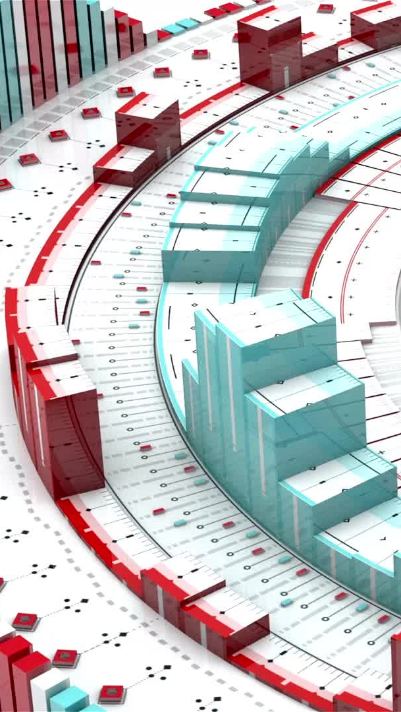
TASK 1 – COMPANY SELECTION
Company selection https://www.intellectdesign.com/
Intellect Design Arena Ltd. Overview
Global Financial Technology Leader: Specializes in innovative, cloud-native, and AI-driven solutions for banking, insurance, and financial institutions.
Diverse Product Portfolio: Offers platforms for retail banking, transaction banking, wealth management, and more.
Global Reach: Serves over 1,000 banks across 150 countries, enhancing digital transformation worldwide.
Award-Winning Excellence: Ranked #1 in Retail Banking, Transaction Banking, and InsurTech by IBS Intelligence.
Comprehensive Digital Solutions: Provides end-to-end platforms for enhancing customer experience and operational efficiency

Slide 3

TASK 2 -PRODUCT DESCRIPTION
1: Intellect Digital Core (IDC)
IDC is a cloud-native, API-first, and microservices- ready core banking platform.
It offers end-to-end financial lifecycle management, integrating banking services like lending, treasury, and credit cards. It's designed to provide an omni-channel experience for customers.
Enables faster go-live, reduces costs, and supports open finance innovations, allowing banks to scale efficiently on the cloud

Slide 4

2.Corporate Banking Suite (iGTB)
iGTB is the world’s first complete Global Transaction Banking Platform.
Includes solutions for corporate treasury, virtual accounts, and digital transaction banking.
Helps banks streamline corporate customer onboarding by 80% faster and increases fee income by up to 70%

Slide 5

3: Wealth Qube
Wealth Qube is a comprehensive digital wealth management solution designed for financial institutions.
Supports omni-channel interactions, straight-through processing (STP), and AI-driven insights.
Enhances customer engagement, supports dynamic portfolio management, and accelerates business outcomes in wealth management

Slide 6

TASK 3 WEBSITE PLATFORM IDENTIFICATION
Identifying Website Platform for Intellect Design
Here we can Use online tools to determine the platform and technologies powering the website.
Tools :
WhatCMS: Detects CMS platforms like WordPress, Drupal, or custom solutions.
BuiltWith: Identifies underlying technologies such as hosting, analytics, and more.
Wappalyzer Extension: Browser add-on that reveals tech stack in real-time.
Intellect Design Arena's website likely uses a custom or proprietary platform, optimized for fintech solutions rather than common CMS platforms.

Slide 7
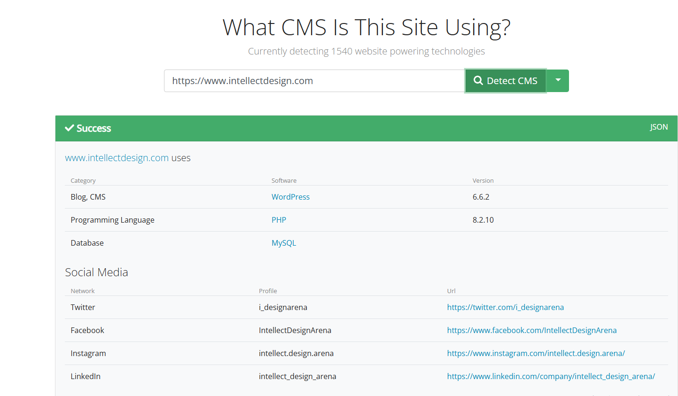
Used What CMS Tool

Slide 8

TASK 4 - RESPONSIVE DESIGN TESTING
Responsive Design Testing ensures a website adjusts smoothly
across different devices (mobile, tablet, desktop) and screen
sizes for an optimal user experience.
Ensures layout changes based on screen size.
Verifies images, text, and buttons scale correctly.
Tests consistency across multiple devices and browsers.
Why It’s Important:
Improves user experience on all devices.
Boosts SEO rankings (Google favors mobile-friendly sites).
Increases audience reach by ensuring accessibility.
Tools to Use:
BrowserStack, Responsinator, Google Mobile-Friendly Test.

Slide 9
Mobile friendly test - Careers
https://seranking.com/free-tools/mobile-friendly-test.html

Slide 10
Mobile friendly test Contact us Page:-

Slide 11
Mobile friendly test – About us

Slide 12
Mobile friendly test – Design center

Slide 13
Mobile friendly test - Technology

Slide 14
Task 5 - Website Design Mistakes & Suggestions
Slow Loading Speed: Optimize images and reduce plugins to improve site performance.
Cluttered Layout: Use white space effectively for a clean, user-friendly interface.
Weak Call-to-Action (CTA): Add clear, prominent CTAs like “Sign Up” or “Learn More.”
Poor Accessibility: Ensure color contrast and keyboard navigation for all users.
Font Overload: Limit to one or two readable fonts with consistent sizes.
These improvements enhance user experience and SEO, promoting higher engagement and conversions.

Slide 15
Task 6 – Best practices in web Design
Clean Layout & White Space: Create a simple, uncluttered layout for easy readability.
Responsive Design: Ensure seamless performance on all screen sizes (mobile to desktop).
Fast Loading Speed: Optimize images and reduce large media for quicker load times.
Clear Navigation: Use intuitive menus and consistent navigation across all pages.
Accessible Design: Ensure color contrast, alt text, and keyboard navigation for inclusivity.

Slide 16
Task 7 – Landing Page Design
A landing page is a standalone web page designed specifically for a marketing or advertising campaign. It’s the first page a visitor "lands" on after clicking a link
https://intellectdesign.my.canva.site/
In short, landing pages are powerful tools for driving engagement, capturing leads, and converting visitors into customers or users.

Slide 17

Thank you

